Slide 1
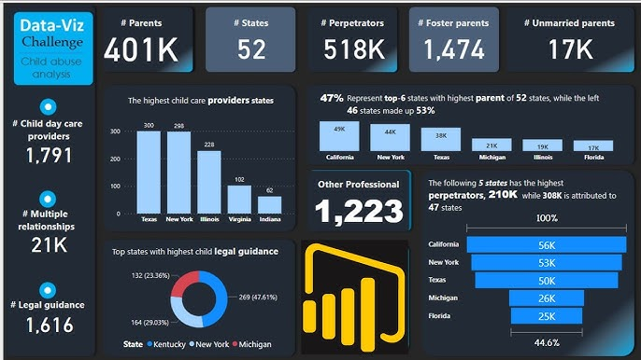

Power BI Dashboard:
Understanding Sales Trends
OBJECTIVE: Diving into key business insights, analyzing trends, and uncovering opportunities with a powerful interactive Power BI dashboard.

Slide 2
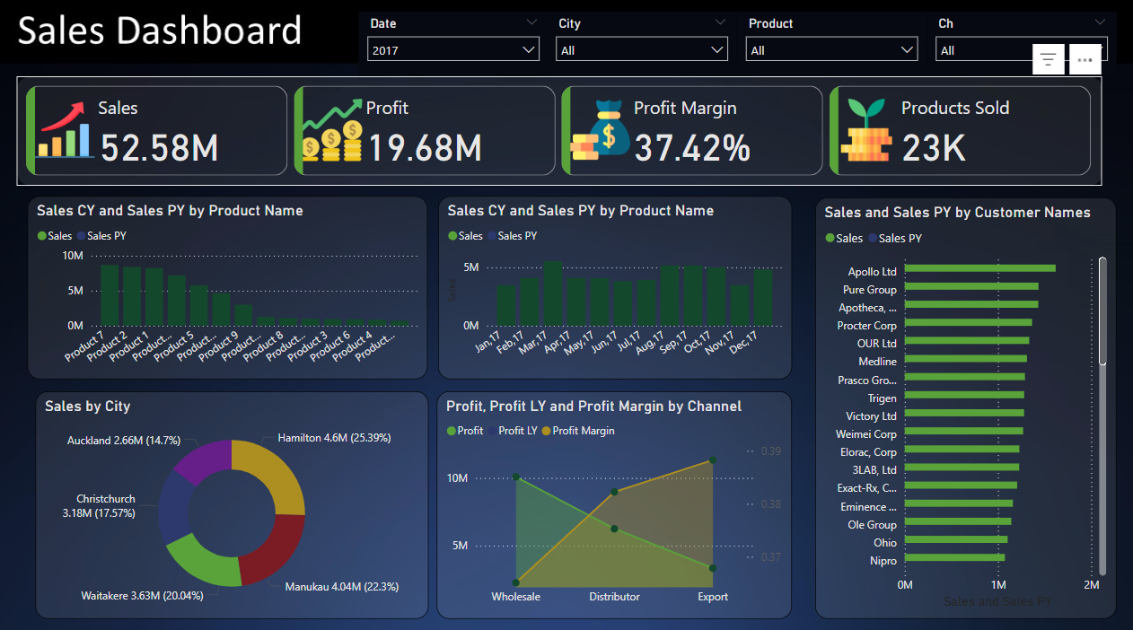
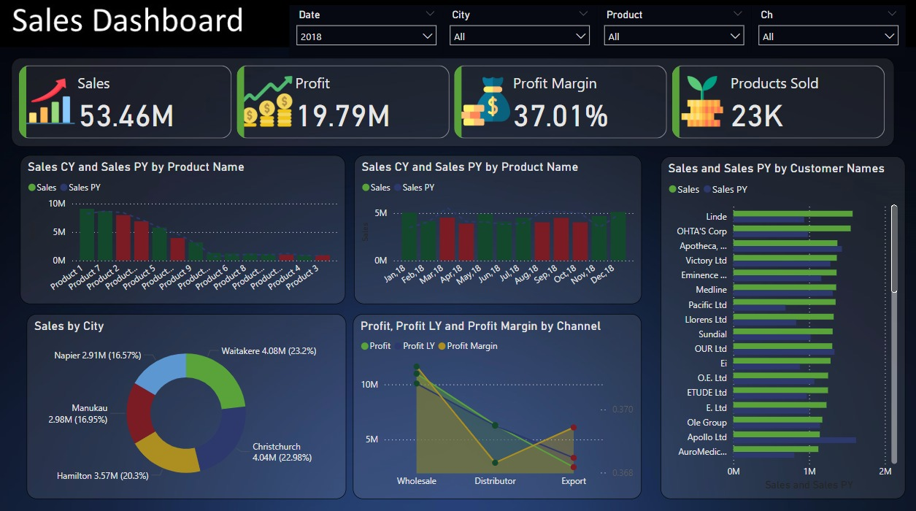
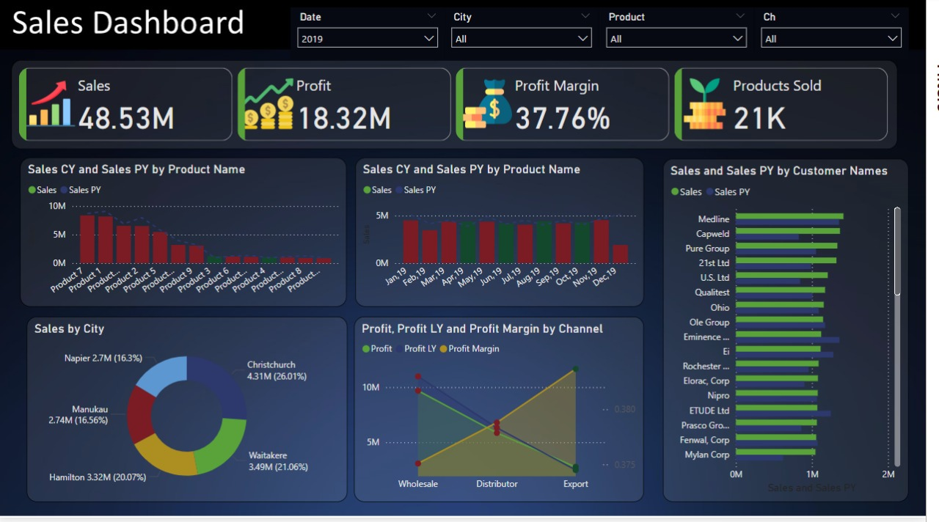

Sales and Profit Trends (2017–2019)
Year | Sales ($M) | Profit ($M) | Profit Margin (%)
2017 | 52.58 | 19.68 | 37.42
2018 | 53.46 | 19.79 | 37.01
2019 | 48.53 | 18.32 | 37.76
While profit margins stayed steady, 2019 saw a downturn in both sales and profits compared to previous years.

Slide 3
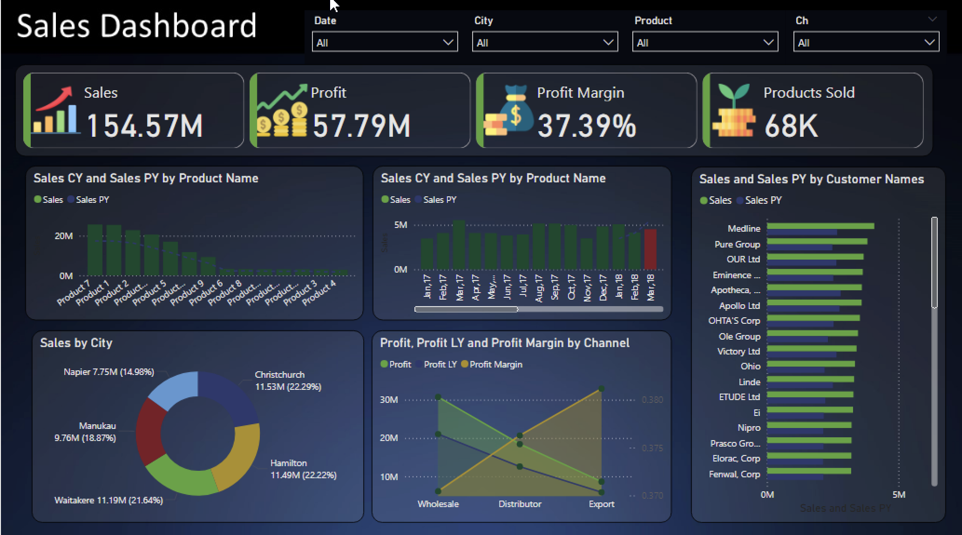
Product-Wise Performance Analysis
Top Performers
Product 1:
Consistently generates the highest sales across all three years.
Strong customer preference and market share indicate sustained demand.
Product 2:
Second highest sales contributor.
Stable performance with room to maintain or marginally increase its market share.
Underperformers
Products 4 and Below:
Minimal contribution to total sales.
Stagnation or decline in growth observed over three years.
Products with lower customer demand, requiring reconsideration or exit strategies.
Growth Potential
Product 3:
Moderate performance but shows potential for improvement through targeted marketing and product enhancements.
Product 5 and Niche Products:
Though lower in current performance, these could grow with innovative marketing and strategic positioning in untapped markets.

Slide 4


City-Wise Sales Trends
High Achievers: Waitakere (2017-2018): Dominated sales in 2017 and 2018. Showed strong customer loyalty during these years. Christchurch (2019): Climbed to the top in 2019 despite overall sales decline. Demonstrates strong potential for sustained leadership. Hamilton & Manukau (2017-2019): Consistently contributed significant sales year-on-year. | Declining Markets: Waitakere (2019): Sales dropped substantially in 2019. Indicates a shift in demand or increased competition. Smaller Cities (All Years): Recorded minimal sales over the years. Represents a less-tapped market or limited demand.

Slide 5
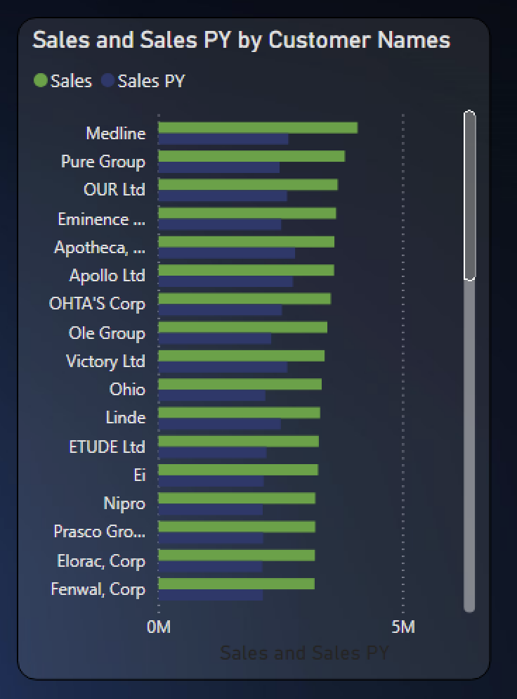
Customer Contribution and Segmentation
• Top-Contributing Customers: Medline, Pure Group, and OUR Ltd are the leading contributors, as their sales values significantly surpass those of other customers.
• Comparison to Previous Year (PY): The side-by-side bar chart allows for direct comparison of current year (CY) and previous year (PY) sales. Customers like Medline and OUR Ltd exhibit consistent performance, while others show notable growth or decline.
• Customer Diversification: The broad distribution of sales among multiple customers indicates diversification, reducing dependence on a single customer for revenue.
• Performance Segmentation: Customers can be segmented into high, medium, and low contributors based on their sales. For example, Medline and Pure Group fall under high-contribution, while customers like Fernwal, Corp are in the lower range.
• Potential Growth Opportunities: Customers showing a gap between CY and PY sales may represent growth opportunities. Understanding reasons for underperformance or decline can help create targeted strategies.
• Industry or Sector: By analysing customer names, potential sectors or industries they belong to (e.g., medical, retail) can provide insights into which industries are driving the most revenue.

Slide 6
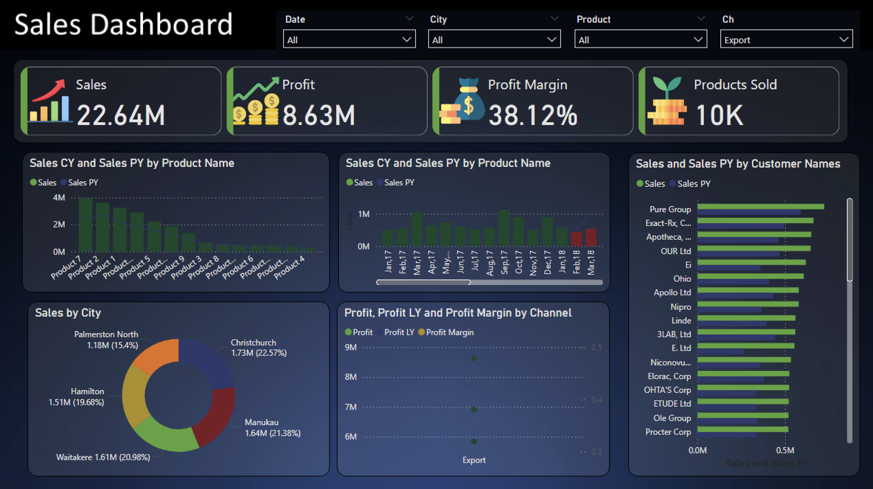
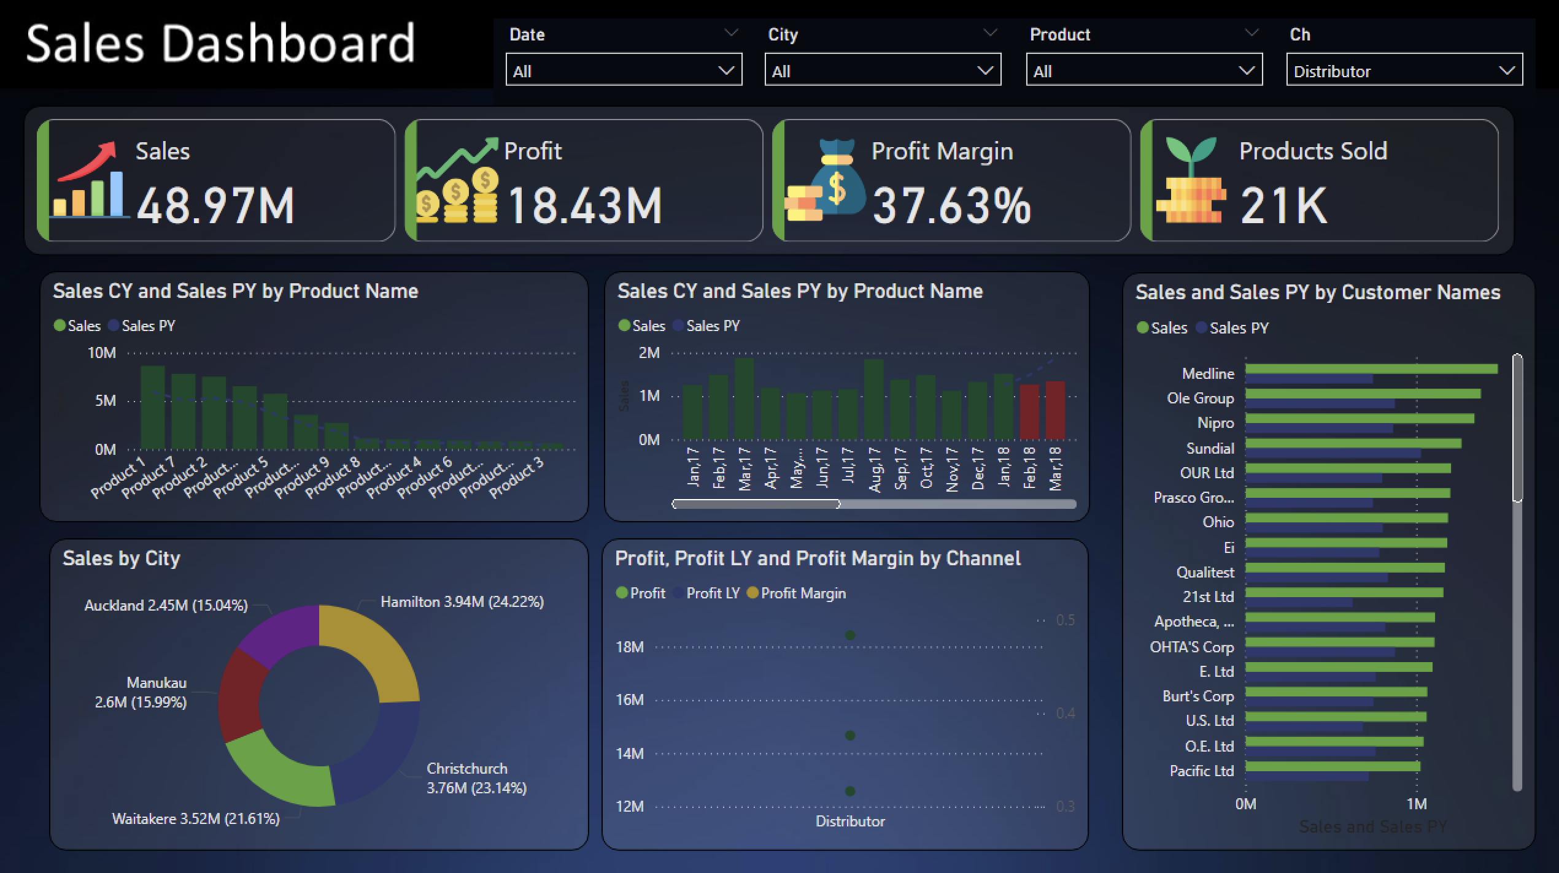
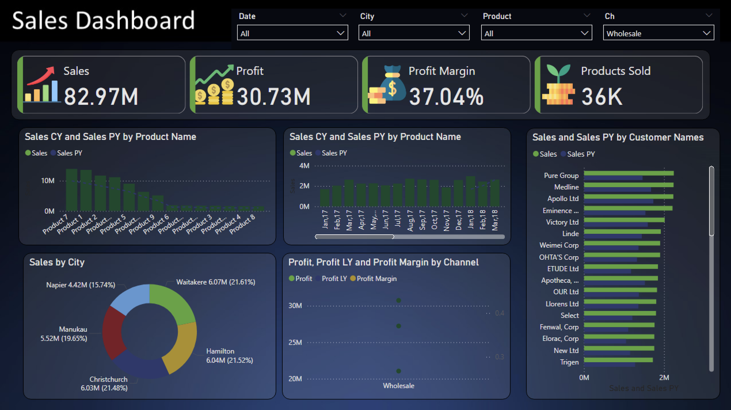
Channel-Wise Performance
Export Channel
Performance Summary:
Sales: $22.64M
Profit: $8.63M
Profit Margin: 38.12% (highest among the three)
Products Sold: 10K
Distributor Channel
Performance Summary:
Sales: $48.97M
Profit: $18.43M
Profit Margin: 37.63%
Products Sold: 21K
Wholesale Channel
Performance Summary:
Sales: $82.97M (highest among the three)
Profit: $30.73M (highest among the three)
Profit Margin: 37.04% (slightly lower but still competitive)
Products Sold: 36K (highest among the three)

Slide 7
Comparative Insights : Channel-Wise
The Export Channel stands out with the highest profit margin of 38.12%, reflecting superior efficiency and profitability. However, it lags behind the other channels in overall sales ($22.64M) and volume (10K products sold), making it the smallest contributor to total revenue. This channel likely operates in niche or premium markets, capitalizing on higher pricing per unit. There is significant potential to expand its market reach and product availability while maintaining its strong margins to boost overall performance.
Exporter
The Distributor Channel strikes a balance between efficiency and profitability, with a profit margin of 37.63%. It generates moderate sales of $48.97M and a profit of $18.43M, positioning itself as a reliable performer. Despite having fewer products sold (21K) compared to Wholesale, it maintains strong efficiency, contributing $0.88K profit per product. This channel is well-suited for scaling up, with opportunities to increase sales through marketing efforts and expanding the distributor network.
Distributor
The Wholesale Channel is the leader in total sales ($82.97M) and profit ($30.73M), driven by its high product volume of 36K. Despite its dominance in overall contribution, it has the lowest profit margin of 37.04%, indicating tighter pricing or higher operational costs. Each product sold generates slightly less efficiency compared to the Distributor and Export Channels. As a high-volume channel, its primary opportunity lies in optimizing operational costs to improve margins further while sustaining its sales leadership.
Wholesaler

Slide 8

Key Insights and Suggested Actions
Product Strategy: Focus on high-performing products (Product 1–5) while devising targeted marketing and promotional efforts for underperforming ones (Product 6 and below). Consider revising pricing or bundling strategies for lower-performing products to stimulate demand.
Regional Expansion: Strengthen presence in Christchurch, Waitakere, and Hamilton while developing campaigns to penetrate and grow markets in Napier and Manukau.
Customer Relationship Management: Build stronger relationships with top customers like Linde, OHTA's Corp, and Apotheca by offering customized incentives, loyalty programs, and exclusive deals. Use their feedback to improve offerings.
Channel Optimization: Leverage the Export Channel's high margins to expand market reach, and improve operational efficiency in the Wholesale Channel to enhance profitability. Invest in scaling up the Distributor Channel to grow its contribution.
Data-Driven Decisions: Regularly monitor product sales, city-wise performance, and customer trends using dashboards to adapt strategies dynamically and capture growth opportunities in real-time.

